Slide 1
CSC 335
Team Members:
Ngoc Minh Tran
Flynn Gaur
Benhur Tadiparti
Jasur Jiasuer
Team 12 - Calendar

Slide 2
Introduction
We chose to do the Calendar Project
We used MVC design structure
Split the work on Trello
Wow Factor: Colored Events

Slide 3
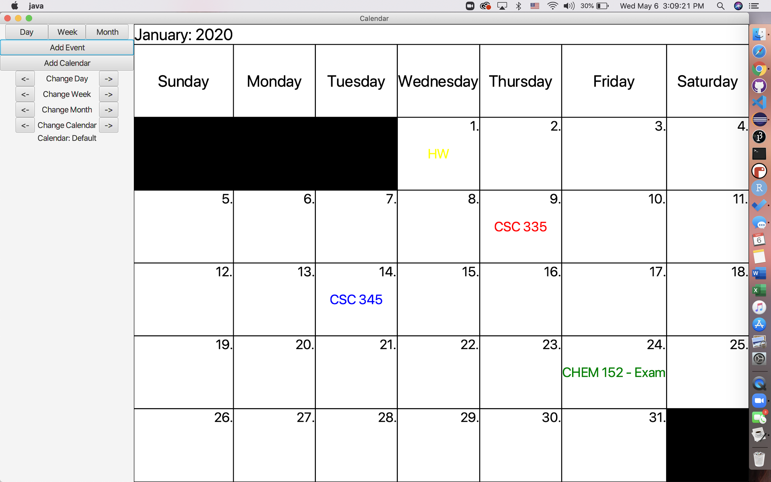
Month View
This is the month
view with a event,
only the earliest
event will show up
in the month view

Slide 4
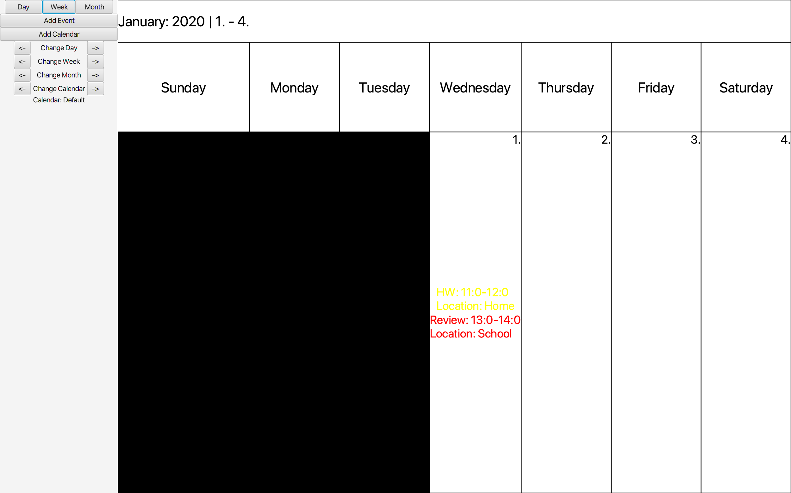
Week View
This is our week
view with 2 events
in first day of
the week.

Slide 5
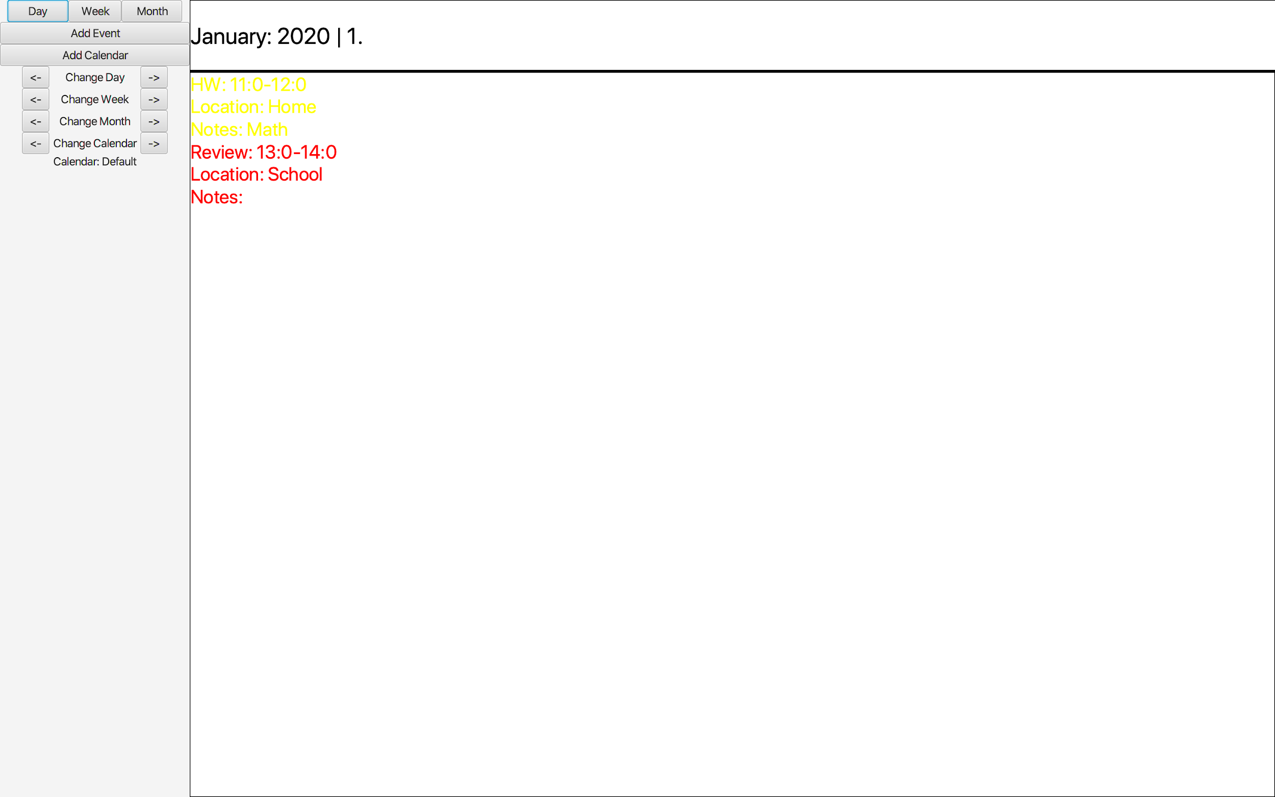
Day View
This is our day view
with 2 events color
coded depending on the
user’s choice.

Slide 6
Add Event
This box is used to take in all the inputs on for creating a new event.
Time is taken in military format to maintain consistency.
Event Location and Notes are optional entries.
There is a drop down box to select a color for the event. The event text is set to the that color. (wow factor)
The field event is not created and an error box is displayed if fields are entered in the wrong format.

Slide 7
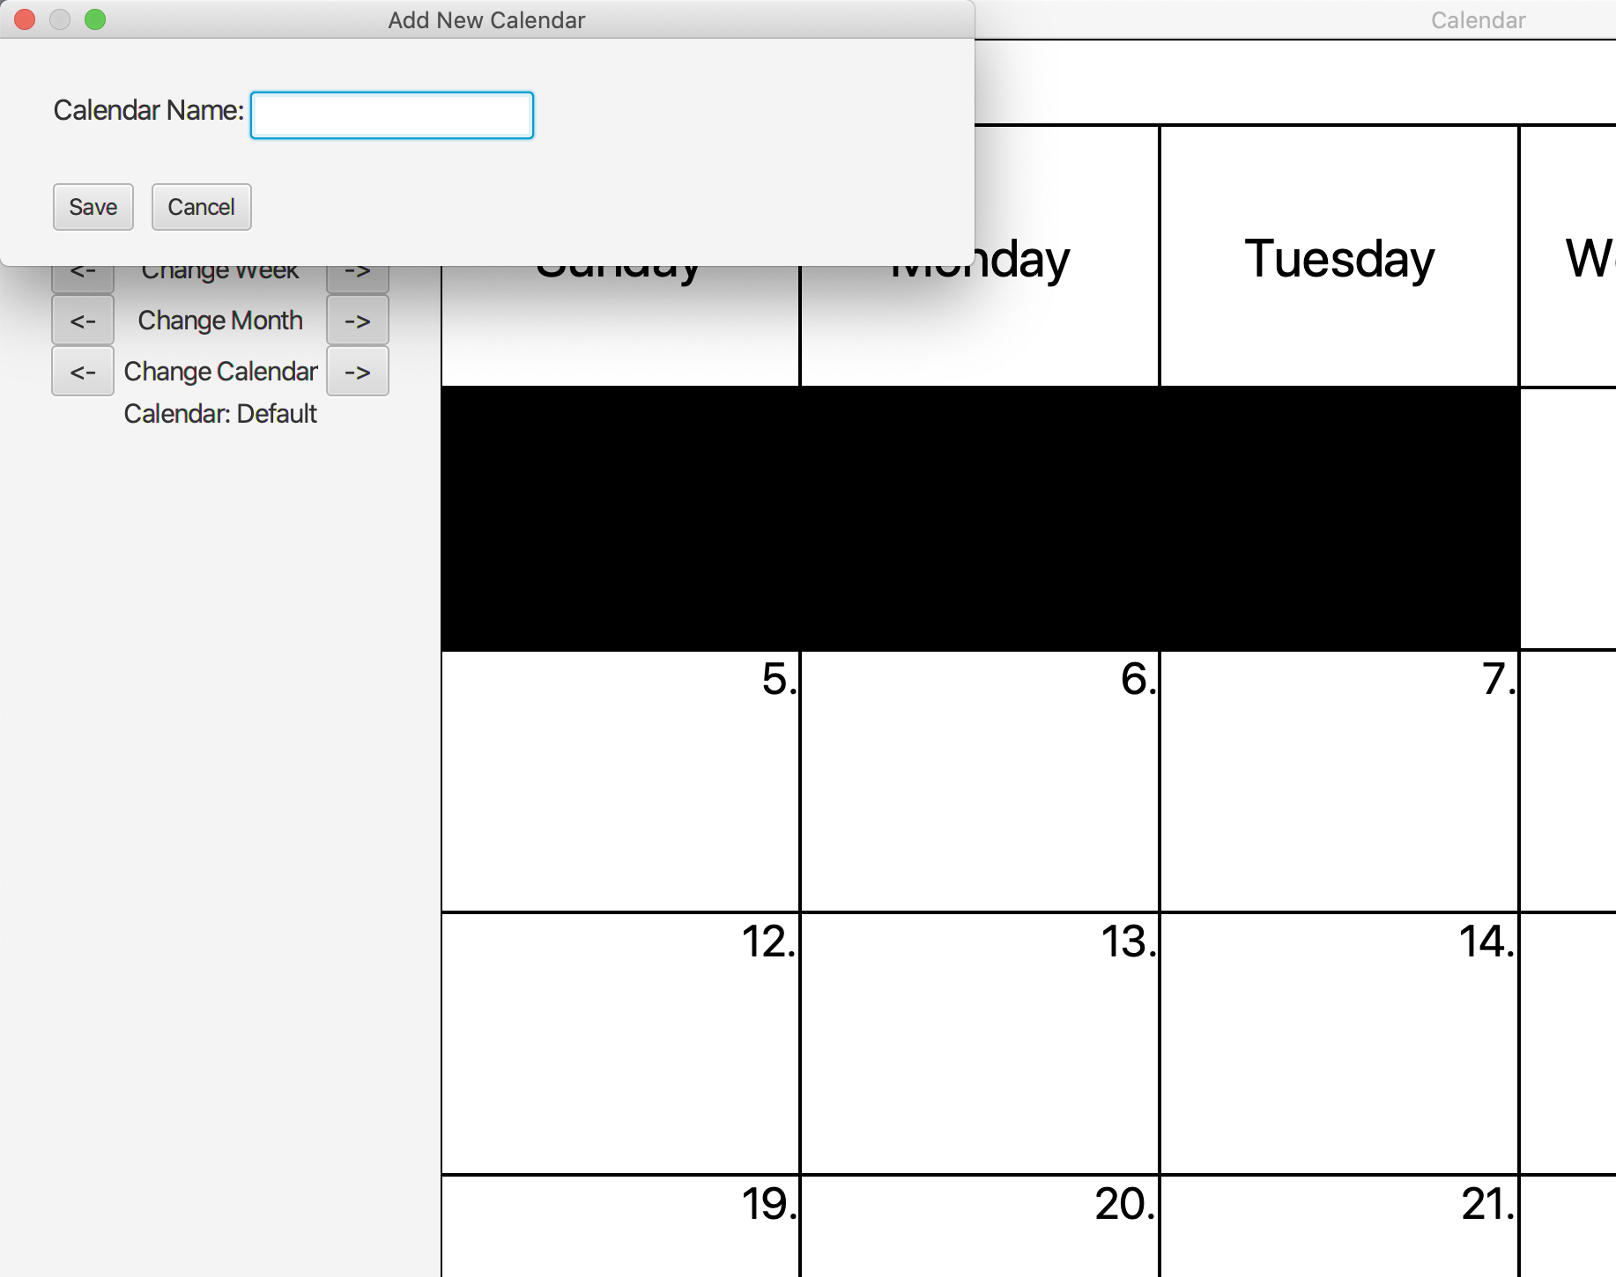
Multiple Calendars
If the user decides to
Create a new calendar,
We will let the user pick
The name and change calendar
By clicking “switch calendar

Slide 8
Save State
We generate a Calendars.txt file storing all Calendar names.
A list of Events corresponding to each Calendar in calendars file will be stored in separated text files named as:
CalendarName_Event.txt
Each event in event file is written in the following format:
name, day, month, start hour, start minute, end hour, end minute, color, location, notes

Slide 9
Save State
Whenever we launch the Calendar, all existing calendars and their corresponding events will be generated and displayed in the View.
Once we close the Calendar, all existing data will be stored in the above-mentioned text files.

Slide 10
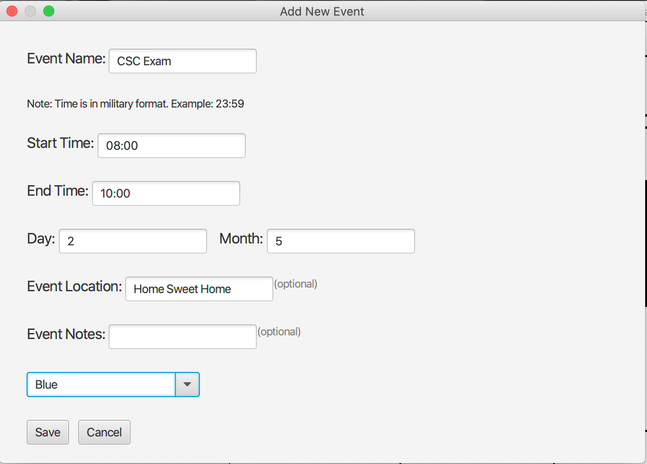

Slide 11
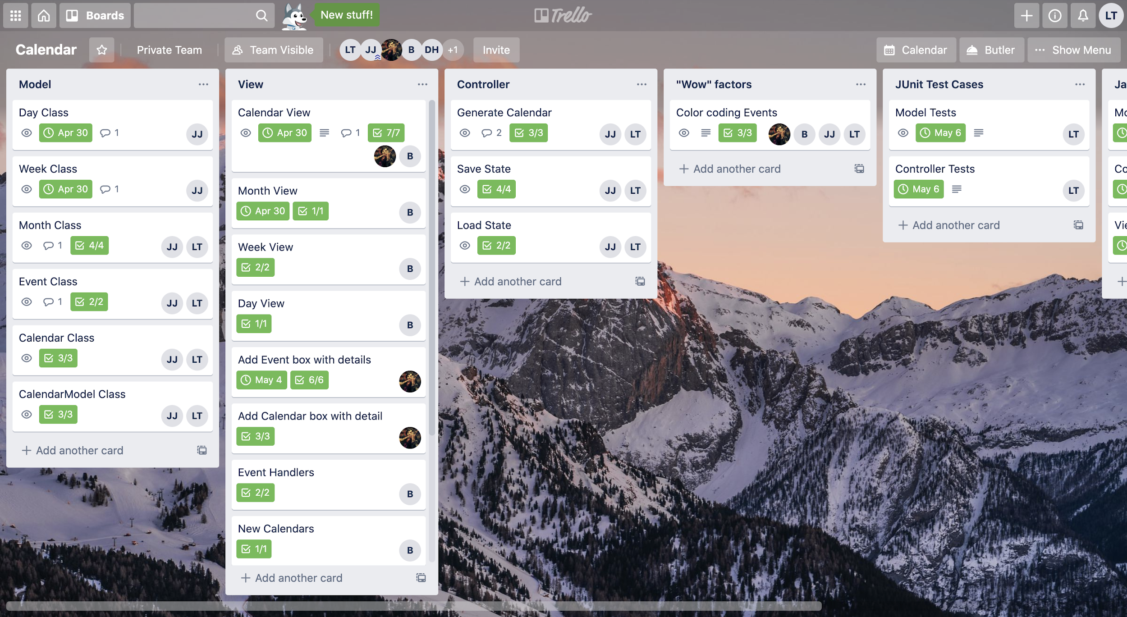
Team Management
We used Trello to assign tasks and keep track of team progress.
We made use of checklists and set due dates for each task.
-

Slide 12
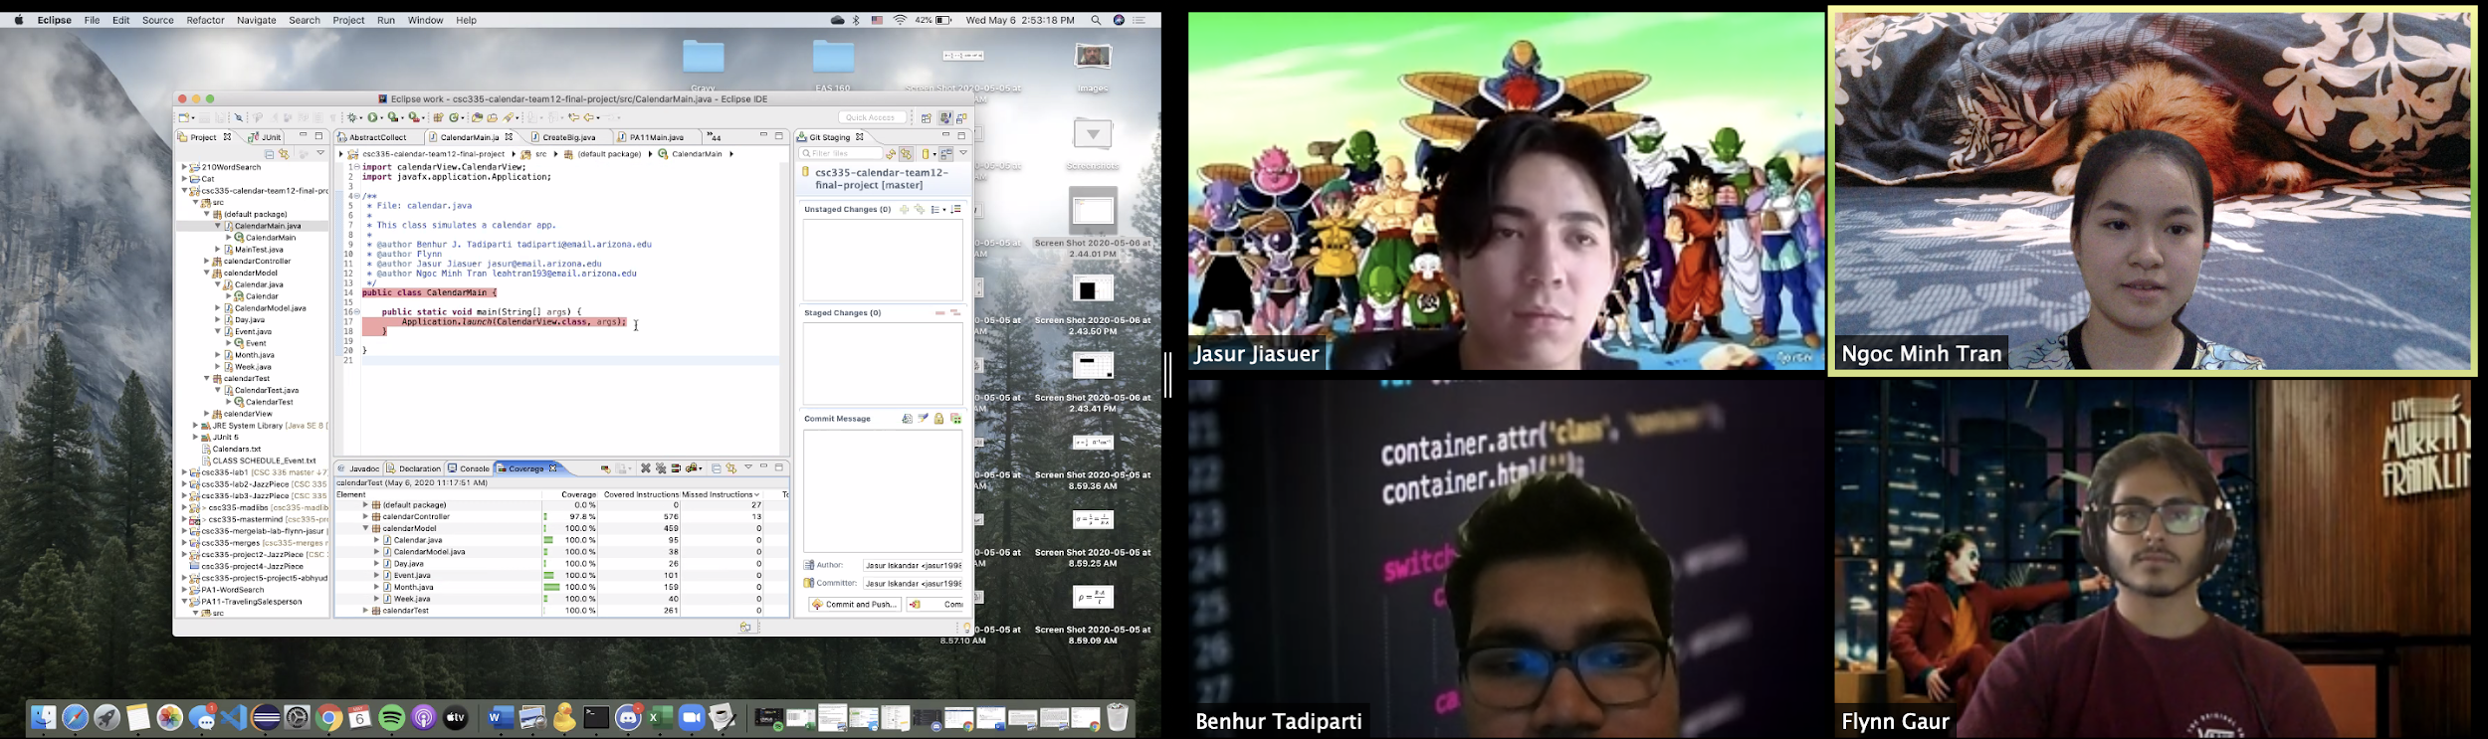
Team Management
We do Zoom meetings every two days to keep track of everyone’s progress, discuss on new ideas, and fix bugs.

